Slide 1
Flask & GCP
Sojasingarayar Abonia

Slide 2
Flask and its usage:
Flask is a lightweight WSGI web application framework.
It is designed to make getting started quick and easy, with the ability to scale up to complex applications. It is one of the most popular Python web application frameworks.
Install Flask:
Within the activated environment, use the following command to install Flask:
$ pip install Flask
With conda:
conda install -c anaconda flask

Slide 3
Flask App routing
App routing is used to map the specific URL with the associated function that is intended to perform some task. It is used to access some particular page in the web application.
In ex below, the URL ('/') is associated with the home function that returns a particular string displayed on the web page.
In other words, we can say that if we visit the particular URL mapped to some particular function, the output of that function is rendered on the browser's screen.
from flask import Flask
app = Flask(__name__)
@app.route('/home')
def home():
return "hello, welcome to our website";
if __name__ =="__main__":
app.run(debug = True)

Slide 4
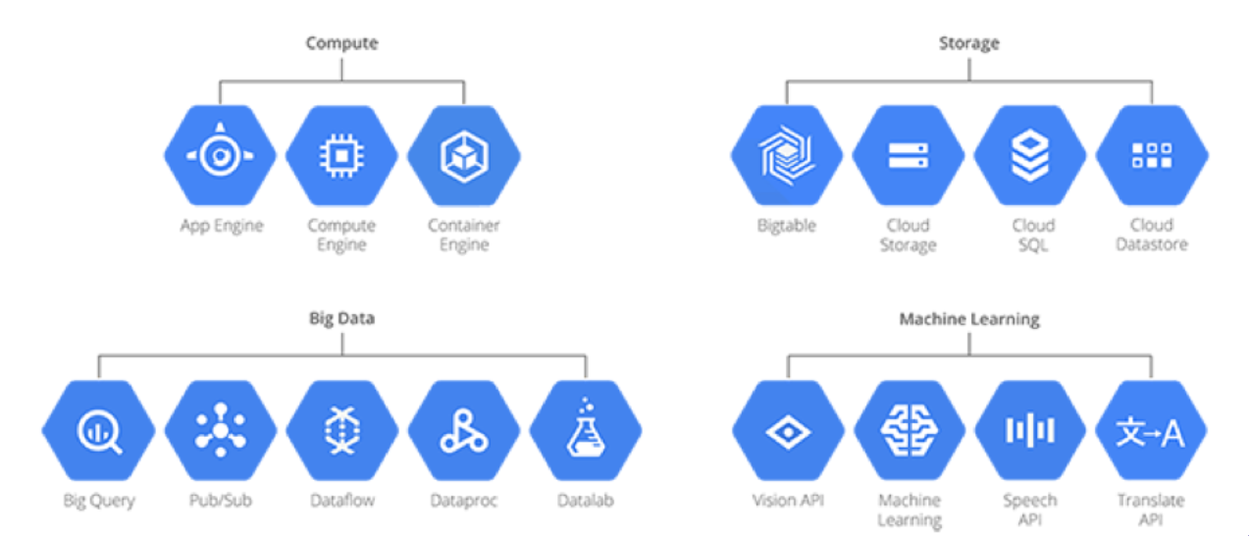
GCP?
Google Cloud Platform (GCP), offered by Google, is a suite of cloud computing services that runs on the same infrastructure that Google uses internally for its end-user products, such as Google Search, Gmail and YouTube.
Alongside a set of management tools, it provides a series of modular cloud services including computing, data storage, data analytics and machine learning.

